Slide 1
Biostatistics-Lecture 1
Ruibin Xi
Peking University
School of Mathematical Sciences

Slide 2
Why Statistics
“I keep saying the sexy job in the next ten years will be statisticians. People think I'm joking, but who would've guessed that computer engineers would've been the sexy job of the 1990s?“
--Hal Valarian (Google Chief Economist)
Read More: Link1, Link2

Slide 3
Why Statistics
Huge amount of data are freely available
  NCBI
  EBI
  1000 Genome Project
  TCGA
  ICGC
  ENCODE
  ……

Slide 4
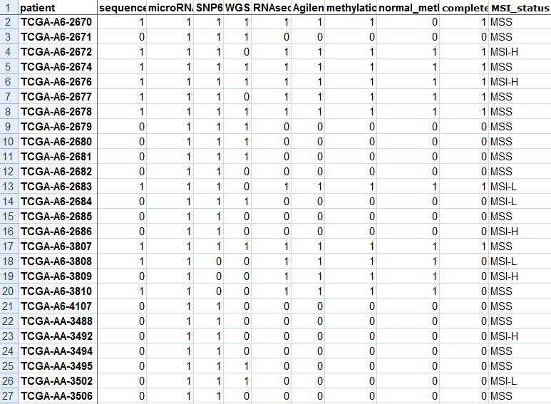
The data
What you expect the data look like

Slide 5
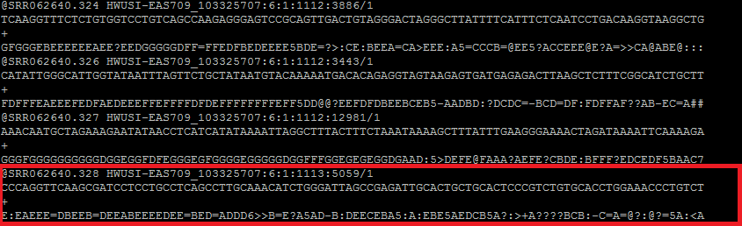
The data
What the data really look like

Slide 6
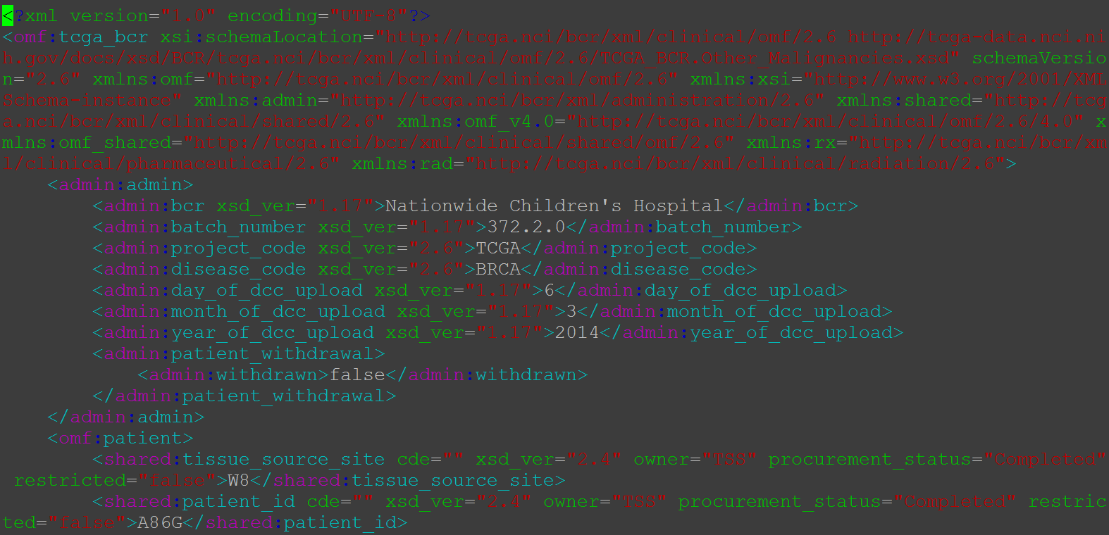
The data
What the data really like

Slide 7

The data
What the data really look like

Slide 8
Statistics in Scientific Research
Statistical methods
  Use empirical evidence (data) to improve knowledge in a targeted population
  Help to make more informed decisions
Empirical evidence
  Measurements of variables about the targeted population, e.g. age, gender, BMI (body mass index), gene expression, genotype etc.

Slide 9

Statistics in Scientific Research– an example (1)
Huntington’s Disease (HD,又名舞蹈病)
  Usually noticeable between 35 to 44
  Jerky, random, uncontrollable movements
  An patient with HD

Slide 10
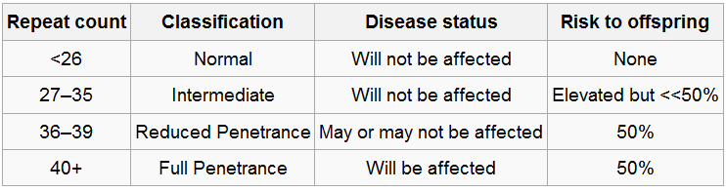
Statistics in Scientific Research– an example (2)
Genetic Factor: (CAG)_{n} repeats in the HTT gene (Walker 2007)

Slide 11
Statistics in Scientific Research– an example (3)
Precise mechanism of neurodegeneration in HD remains unknown
Existing knowledge
  The role of oxidative damage in HD brains
  the antioxidants seem to be effective to decrease the progression of the disease in animal models
  L-carnitine may have antioxidant properties
Notes:
左旋肉碱 (L-carnitine)，又称L-肉碱或 音译卡尼丁，是一种促使脂肪转化为能量的类氨基酸，红色肉类是 左旋肉碱的主要来源，对人体无毒副作用。不同类型的日常饮食已经含有5-100毫克的左旋肉碱，但一般人每天只能从膳食中摄入50毫克，素食者摄入更少。 左旋肉碱的主要生理功能是促进 脂肪转化成能量，服用左旋肉碱能够在减少身体脂肪、降低体重的同时，不减少水分和肌肉，在2003年被国际肥胖健康组织认定为最安全无副作用的减肥营养补 充品。

Slide 12
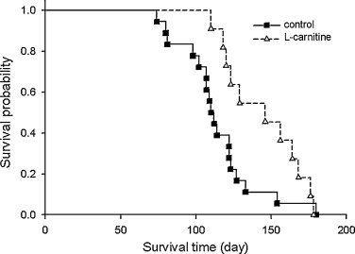
Statistics in Scientific Research– an example (4)
Vamos et al. (2010) studied neuroprotective effects of L-carnitine in transgenic mice with HD
  Population: mice with HD
  Variable: whether a mouse in the treatment group or in the control group, survival time of a mouse
  Conclusion: L-carnitine may have neuroprotective effects
p < 0.05

Slide 13
Types of variables
Categorical variables
  E.g. gender, race, severity of pain (mild, moderate, severe)
  Can be either nominal (e.g. gender, race) or ordinal (e.g. severity of pain)
Quantitative variables
  E.g. Survival time, blood pressure, BMI, gene expression

Slide 14
Statistics in Scientific Research—sampling
Sampling is the 1st step of a scientific research
  A sample: a random selection of a population
A sample must be representative of the population
A sample should be randomly selected (i.e. with some probability) from the population
Samples are often assumed to be independent

Slide 15
Statistics in Scientific Research—data collection
Scientific research can be classified as
  Observational research
  Experimental research
Observational research
  Researchers simply measure or observe all relevant variables
Experimental research
  Control what you can, randomize what you cannot
  Researchers try to control the process as much as possible and randomize factors that cannot be controlled

Slide 16
Observational study—an example(1)
Thun et al. (1992) studied risk factors for fatal colon cancer
  Studied 764,343 adults who completed a questionnaire in 1981 on diet and other risk factors, but no cancer or other major disease
  1150 death from colon cancer until 1988
  Compared these patients with 5746 matched control subjects drawn from the cohort

Slide 17
Observational study—an example(2)
Analysis shown that
  Risks of colon cancer decreases with more consumption of vegetables and high-fiber grains
  Regular use of low does of aspirin may help prevent colon cancer
  No associations were seen with consumption of read meat, physical inactivity and obesity.

Slide 18
Statistics in Scientific Research—data exploration and analysis (1)
Caution!
  Statistics is NOT magic
  Important factors must be considered in the statistical model
  Bias or improper use of statistical tools can give serious misleading results
  Ioannidis (a epidemiologist at Stanford) even claimed that “most of published findings are false”

Slide 19
Statistics in Scientific Research—data exploration and analysis
After data are collected, check the data first
  Look at the distribution of each variable (using histogram, boxplot, barplot, scatter plot)
  Can help to identify problems in the data (e.g. outliers), discovery unknown patterns or unknown relationship
Build appropriate statistical models and perform proper statistical inferences
  HD example: simply use log rank test
  Colon example: need to use more complex models such as regression models

Slide 20
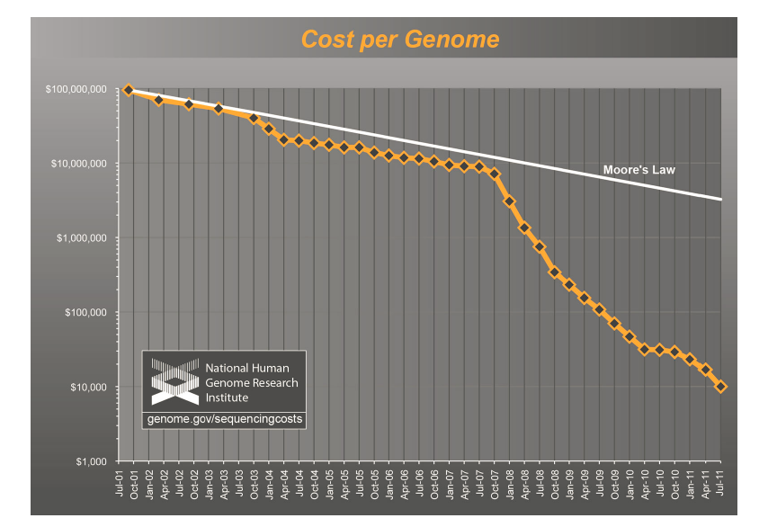
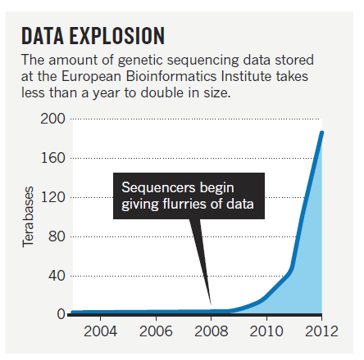
Challenges in the big data era
Data Size is exponentially increasing
First $1000 human genome: Illumina announced its latest HiSeq X Ten machine

Slide 21
Challenges in the big data era
Massive amount of data requires statistical methods and computational algorithms
  Computational very efficient
  Capable of processing intrinsic heterogeneity in the data
  Capable of helping researcher to efficiently perform various model fitness checking
  Visualization of the data at various abstraction level.

Slide 22
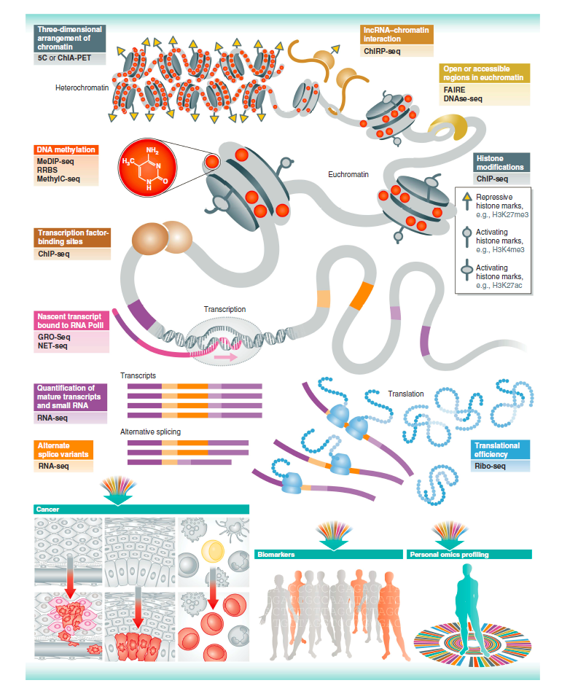
Challenges in the big data era
Data is getting more complicated and contain various level of information

Slide 23
Challenges in the big data era
The ever increasing complexity of the data potentially allows building more accurate model
  Appropriate model is harder to develop due to the complexity of the data
But may also suffer from the curse of dimensionality

Slide 24
Computation
We will frequently use R for data analysis
http://cran.r-project.org/
Many biological tools and software are developed under Linux. Some knowledge about Linux is enssential.

