Slide 1
Biostatistics-Lecture 2
Ruibin Xi
Peking University
School of Mathematical Sciences

Slide 2
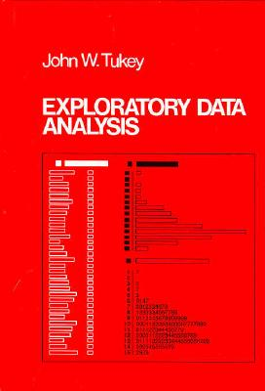
Exploratory data analysis (EDA)

Slide 3
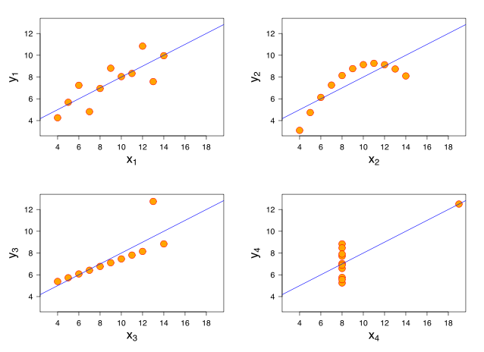
Importance of Plotting
Statistical test/summary or plot ?
This doesn't mean don't think!
Choosing how to make plots and using them to convince yourself/others that trends are real is an important skill.
Anscombe's quartet

Slide 4
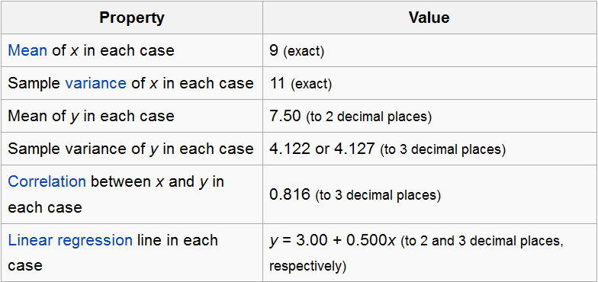
Importance of Plotting
statistical test/summary or plot ?
This doesn't mean don't think!
Choosing how to make plots and using them to convince yourself/others that trends are real is an important skill.
Anscombe's quartet

Slide 5
EDA
EDA is part statistics, part psychology
Unfortunately we are designed to find patterns even when there aren't any
Visual perception is biased by your humanness.
Not fool yourself in EDA

Slide 6
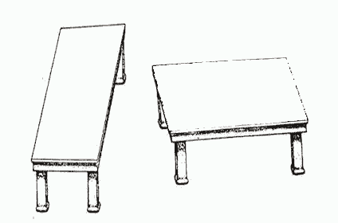
Visual illusion
http://brainden.com/visual-illusions.htm

Slide 7

Visual illusion
http://brainden.com/visual-illusions.htm

Slide 8
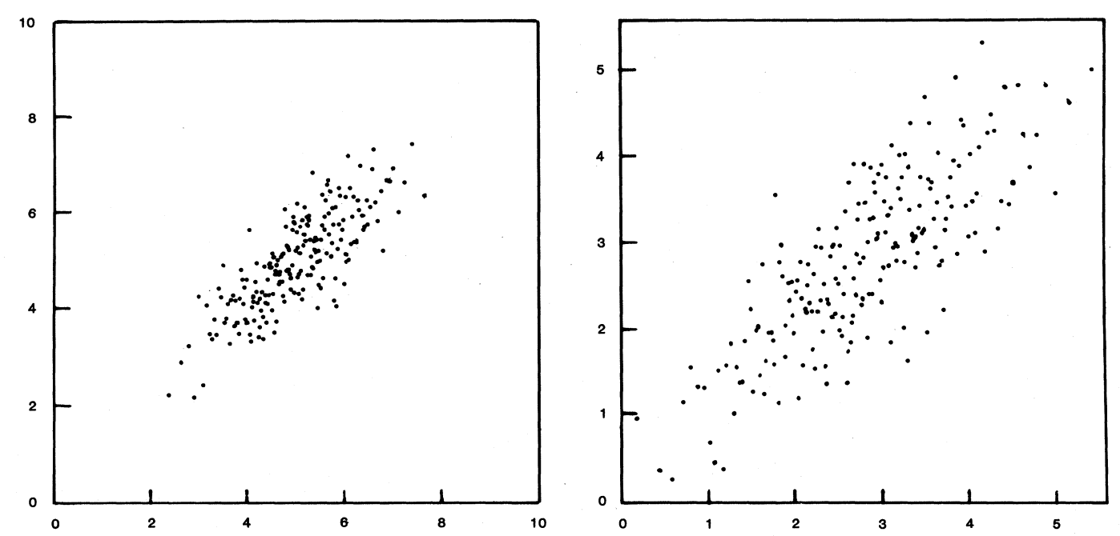
Scale Matters
Variables on Scatterplots Look More Highly Correlated When the Scales are Increased

Slide 9
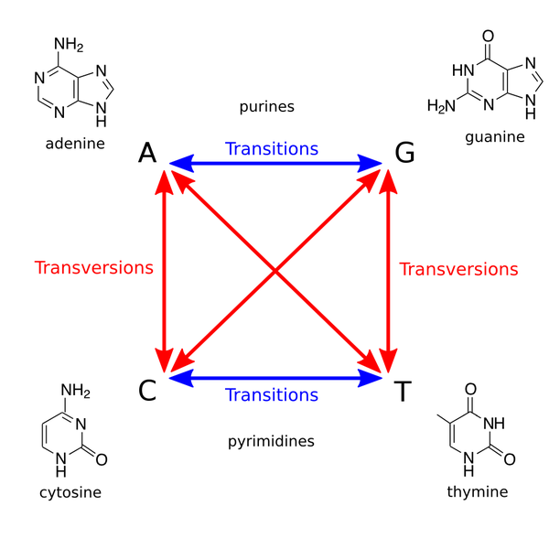
Data Exploration—categorical variable (1)
Single Nucleotide Polymorphism

Slide 10
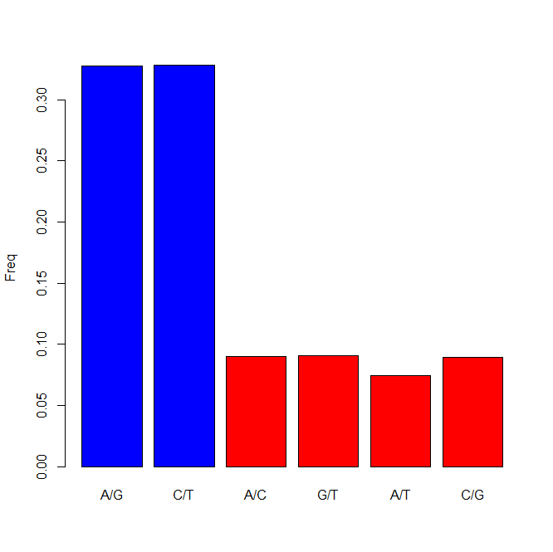

Data Exploration—categorical variable (2)
Zhao and Boerwinkle (2002) studied the pattern of SNPs
Collected all available SNPs in NCBI through 2001
Look at the distribution of the different SNPs
Why much more transitions?
Bar Graph

Slide 11
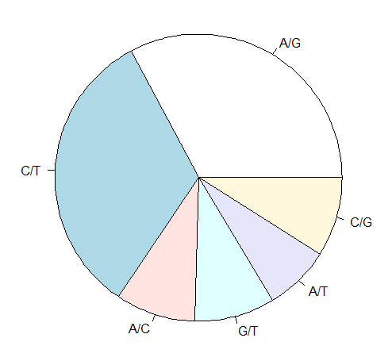
Data Exploration—categorical variable (2)
Zhao and Boerwinkle (2002) studied the pattern of SNPs
Collected all available SNPs of human genome in NCBI through 2001
Look at the distribution of the different SNPs
Why much more transitions?
Pie Graph

Slide 12
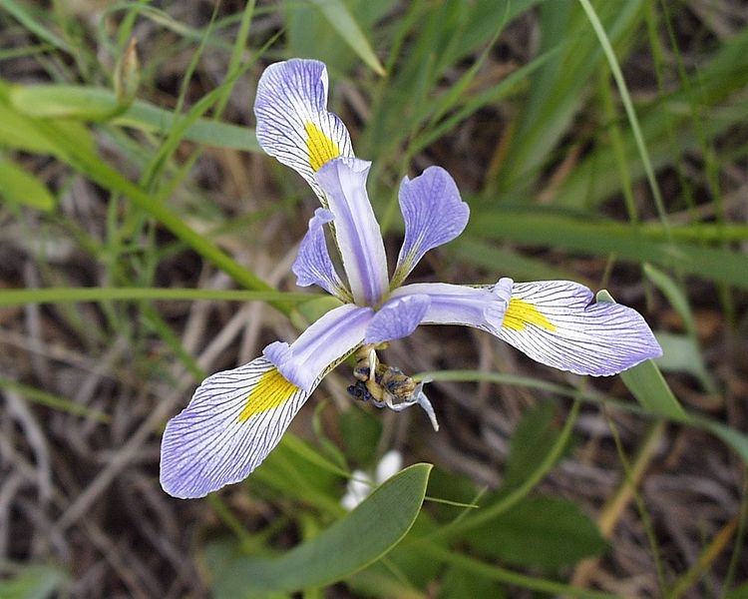
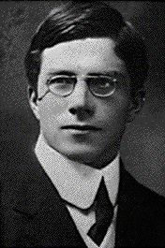
Data exploration—quantitative variable (1)
Fisher’s Iris data
E. S. Anderson measured flowers of Iris
Variables
  Sepal (萼片) length
  Sepal width
  Petal (花瓣) length
  Petal width
Iris
Notes:
Iris: 鸢尾花
Anova develped by Fisher
P-value was popularized because of his book Statistical Methods for Research Workers
Null hypothesis was origninated from Fisher in his book The Design of Experiments (Tea tasting)
He was the first to use the word “Bayesian”

Slide 13
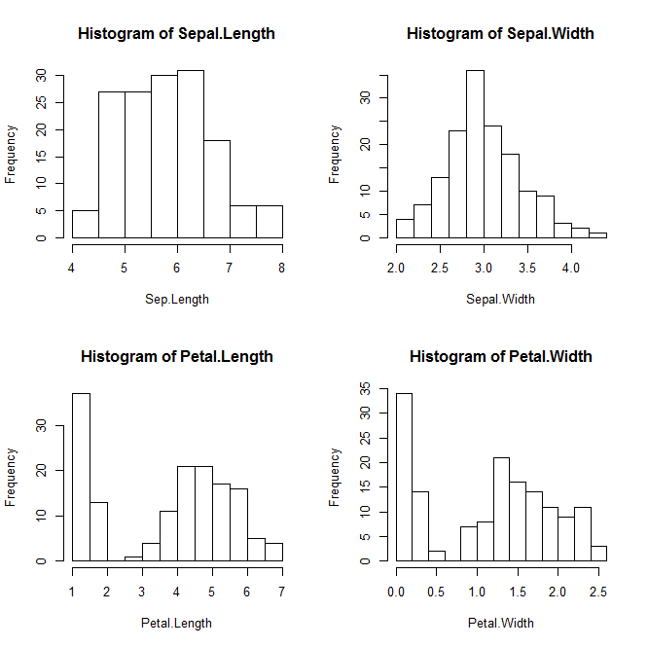
Data exploration—quantitative variable (2)
Histogram (直方图)
Unimode distribution
bimode distribution
What is the possible reason
for the two peaks?

Slide 14
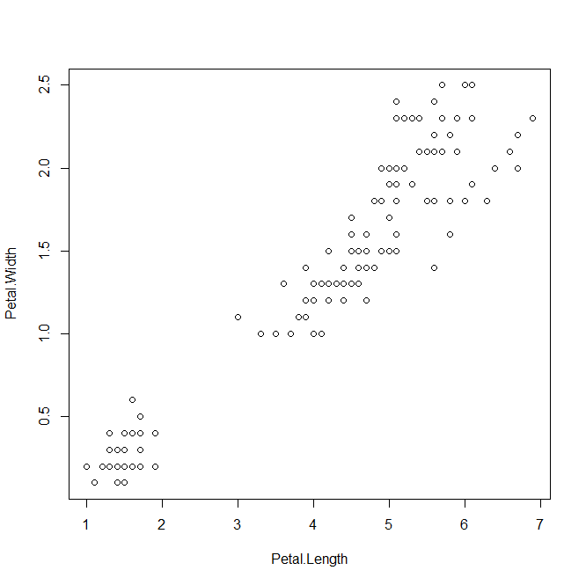
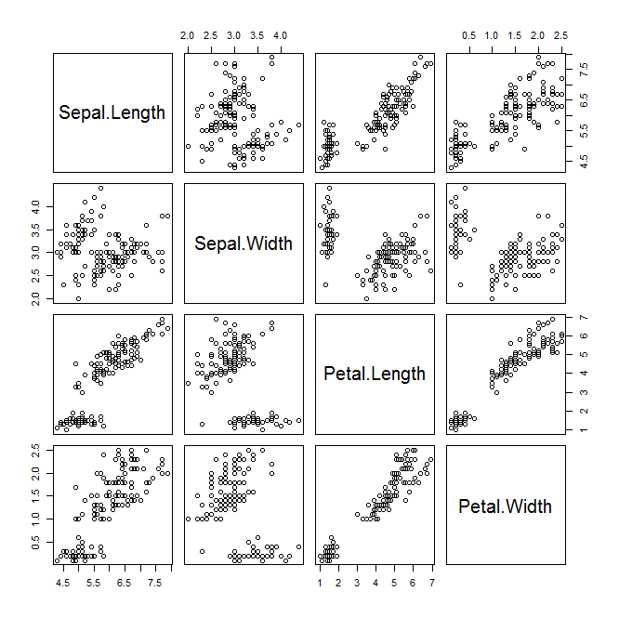
Data exploration—quantitative variable (2)
Scatter plot (散点图)
Cluster 2
Cluster 1

Slide 15
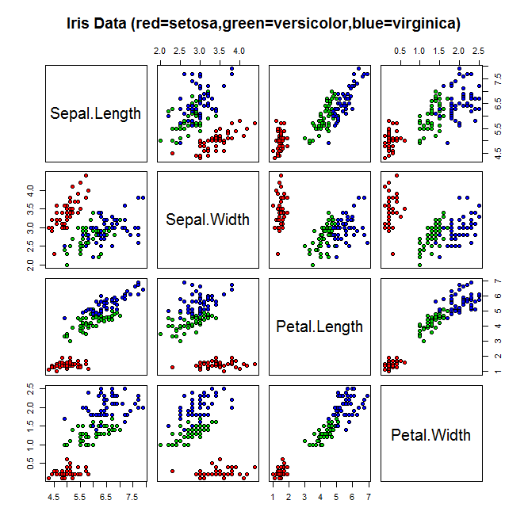
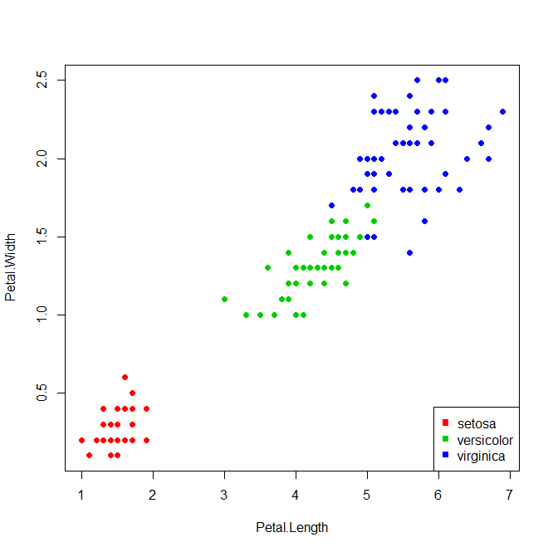
Data exploration—quantitative (3) variable (2)
In fact, there are three species of iris
  Setosa, versicolor and virginica

Slide 16

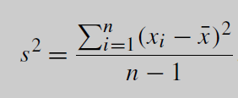
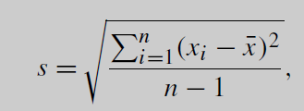
Summary statistics
Sample mean
Sample median
Sample variance
Sample standard deviation

Slide 17
Quantiles
Median: the smallest value that greater than or equal to at least half of the values
qth quantile: the smallest value that greater than or equal to at least 100q% of the values
1st quantile Q1: the 25% quantile
3rd quantile Q3: the 75% quantile
Interquantile range (IQR): Q3-Q1

Slide 18
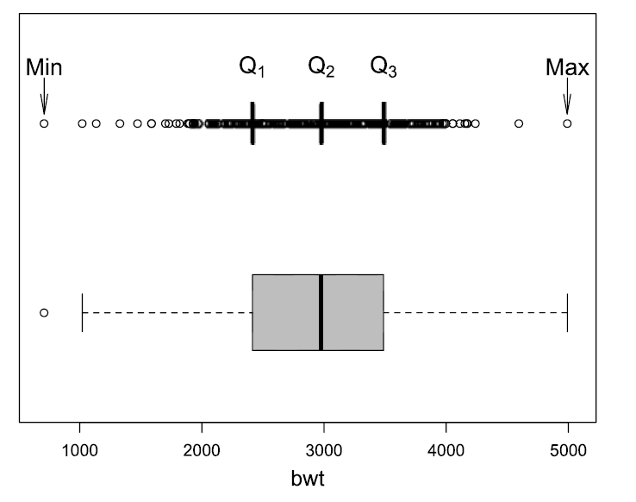
Boxplot
IQR
1.5IQR

Slide 19
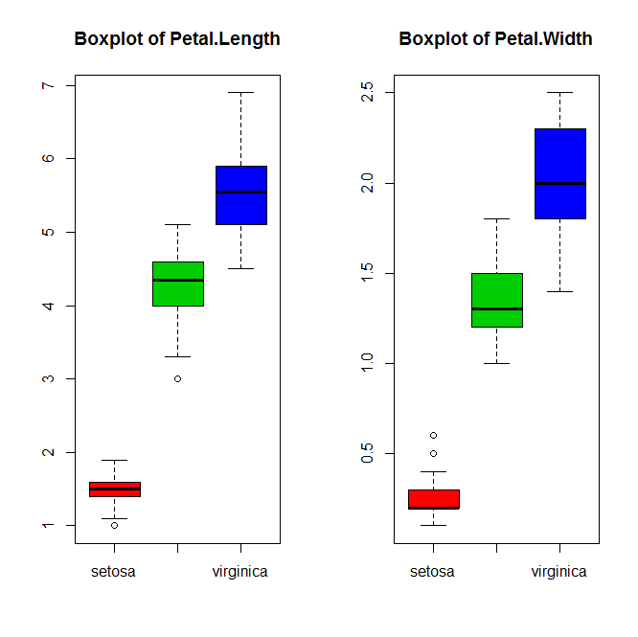
Data exploration—quantitative (4)
Boxplot

Slide 20
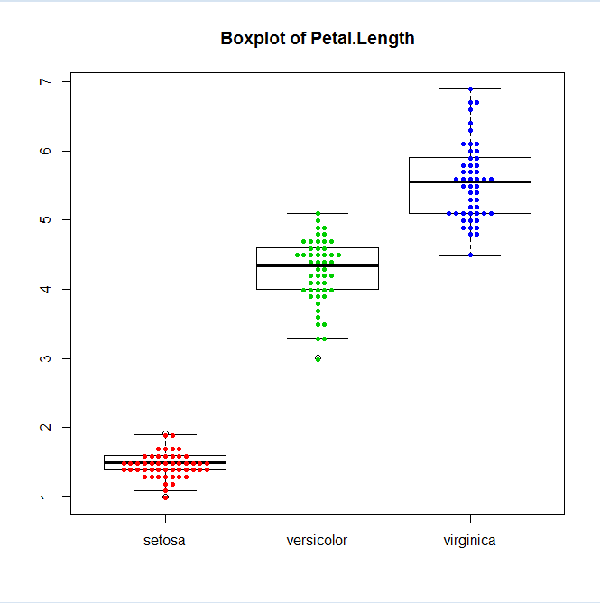
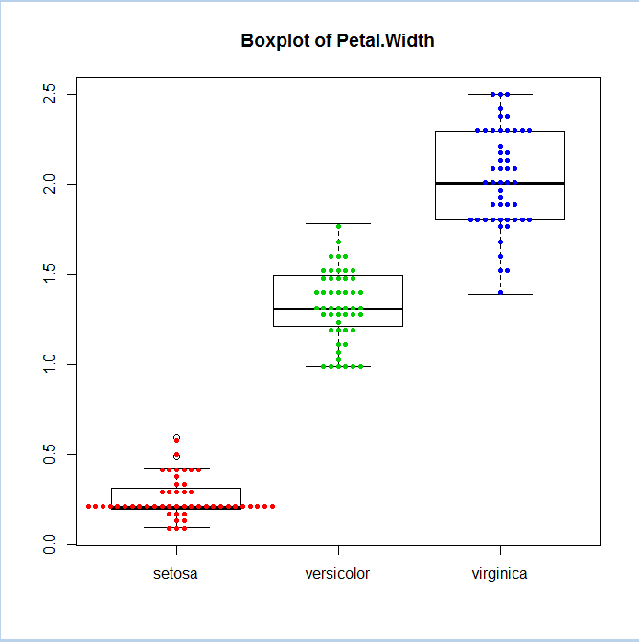
Data exploration—quantitative (5)
Bee swarm plot

Slide 21
Relationships between categorical variable (1)
A study randomly assigned 11034 physicians to case (11037) or control (11034) group.
In the control group
  189 (p1=1.71%) had heart attack
In the case group
  104 (p2=0.94%) had heart attack

Slide 22





Relationships between categorical variables (2)
Relative risk
Odds ratio
  Sample Odds
  Odds ratio

Slide 23
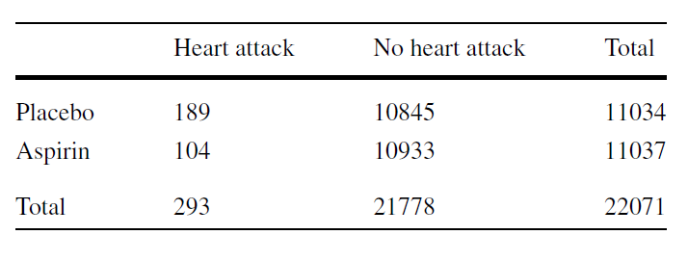
Relationships between categorical variable (3)
Contingency table
Does taking aspirin really reduces heart attach risk?
  P-value: 3.253e-07 (one sided Fisher’s test)

Slide 24
Probability
Randomness
  A phenomenon (or experiment) is called random if its outcome cannot be determined with certainty before it occurs
  Coin tossing
  Die rolling
  Genotype of a baby

Slide 25
Some genetics terms (1)
Gene: a segment of DNA sequence (can be transcribed to RNA and then translated to proteins)
Allele: An alternative form of a gene
Human genomes are diploid (two copies of each chromosome, except sex chromsome)
Homozygous, heterozygous: two copies of a gene are the same or different

Slide 26
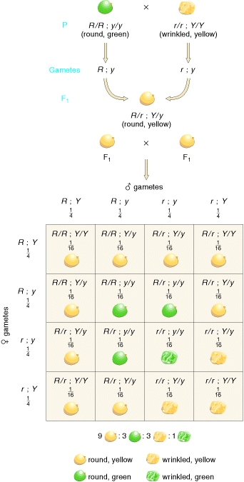
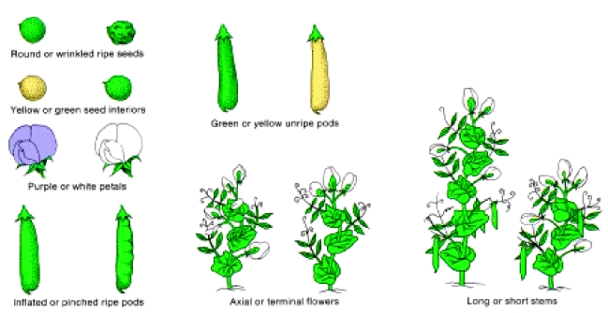
Some genetics terms (2)
Genotype
  In bi-allele case (A or a), 3 possible outcomes
  AA, Aa, aa
Phenotype
  Hair color, skin color, height
  小指甲两瓣（大槐树下先人后代？）
Genotype is the genetic basis of phenotype
Dominant, recessive
Phenotype may also depend on environment factors

Slide 27
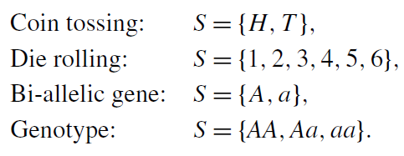
Probability
Sample Space S:
  The collection of all possible outcomes
The sample space might contain infinite number of possible outcomes
  Survival time (all positive real values)

Slide 28
Probability
Probability: the proportion of times a given outcome will occur if we repeat an experiment or observation a large number of times
Given outcomes A and B
  If A and B are disjoint

Slide 29
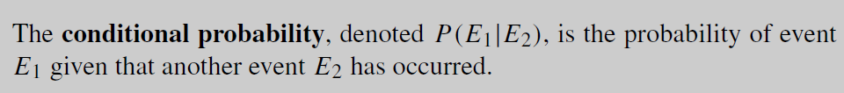

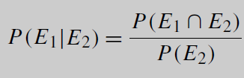
Conditional probability
Conditional probability
In the die rolling case
  E1 = {1,2,3}, E2 = {2,3}
  P(E1|E2) = ?, P(E2|E1) = ?
Assume

Slide 30
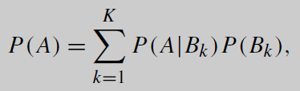
Law of Total Probability
From the conditional probability formula
In general we have

Slide 31



Independence
If the outcome of one event does not change the probability of occurrence of the other event
For two independent events

Slide 32
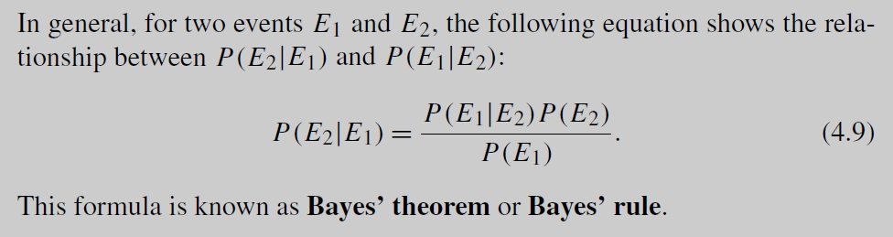
Bayesian rule

Slide 33
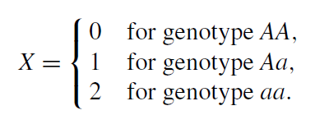

Random variables and their Distributions (1)
Random variable X assigns a numerical value to each possible outcome of a random experiment
  Mathematically, a mapping from the sample space to real numbers
For the bi-allelic genotype case, random variables X and Y can be defined as

Slide 34
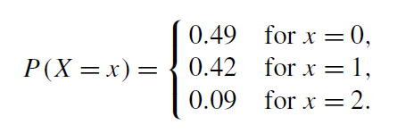
Random variables and their Distributions (2)
Probability distribution
  A probability distribution specifies the range of a random variable and its corresponding probability
In the genotype example, the following is a probability distribution

Slide 35
Random variables and their Distributions (3)
Discrete random variable
  Only take discrete values
  Finite or countable infinite possible values
Continuous random variable
  take values on intervals or union of intervals
  uncountable number of possible values
  Sepal/petal length, width in the iris data
  Weight, height, BMI …

Slide 36
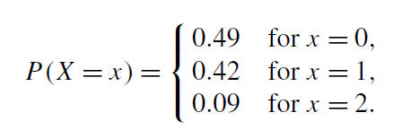
Distributions of discrete random variable (1)
Probability mass function (pmf) specifies the probability P(X=x) of the discrete variable X taking one particular value x (in the range of X)
In the genotype case
Summation of the pmf is 1
Population mean, population variance

Slide 37
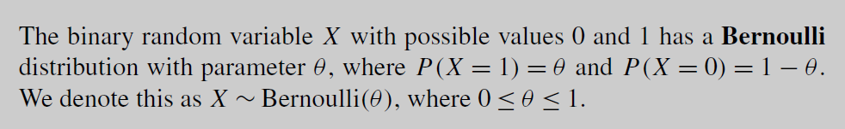
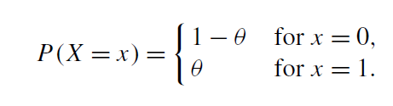
Distributions of discrete random variable (2)
Bernoulli distribution
The pmf

Slide 38
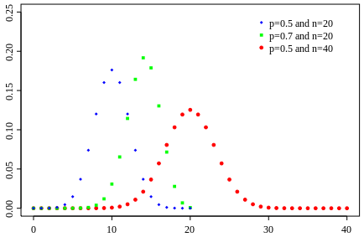

Distributions of discrete random variable (3)
Binomial distribution
  Summation of n independent Bernoulli random variables with the same parameter
  Denoted by
  The pmf

Slide 39
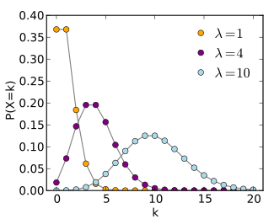

Distributions of discrete random variable (4)
Poisson distribution
  A distribution for counts (no upper limits)
The pmf

Slide 40

Distributions of discrete random variable (4)
Poisson distribution
  A distribution for counts (no upper limits)
The pmf
Feller (1957) used for model the number of bomb hits in London during WWII
  576 areas of one quarter square kilometer each
  λ=0.9323

Slide 41
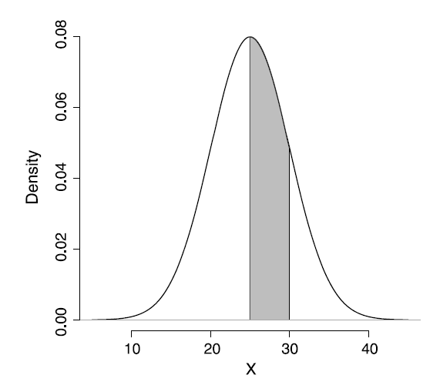

Distributions of continuous variables (1)
Use probability density function (pdf) to specify
If the pdf is f, then
Population mean, variance
Cumulative distribution (cdf)
pdf

Slide 42
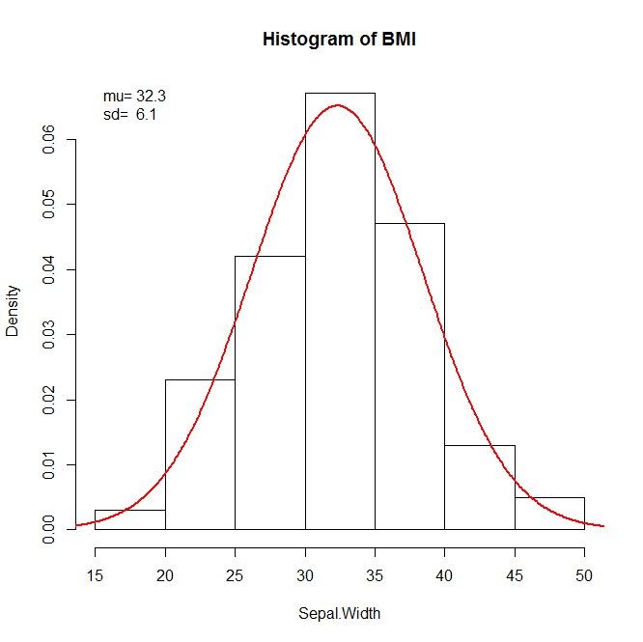


Distributions of continuous variables (2)
Normal distribution
  The pdf
The distribution of the BMI variable in the data set Pima.tr
can be viewed as a normal distribution (MASS package)

Slide 43

Distributions of continuous variables (3)
Student’s t-distribution (William Sealy Gosset)
Chi-square distribution
Gamma distribution
F-distribution
Beta distribution

Slide 44
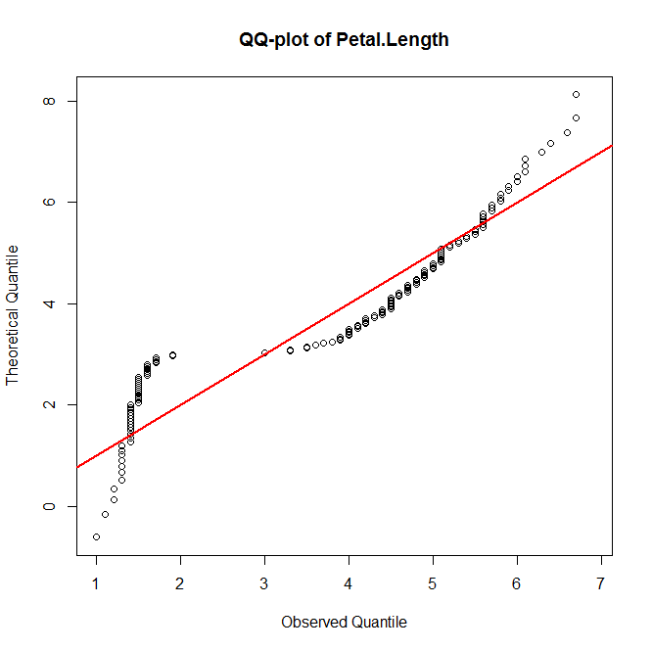
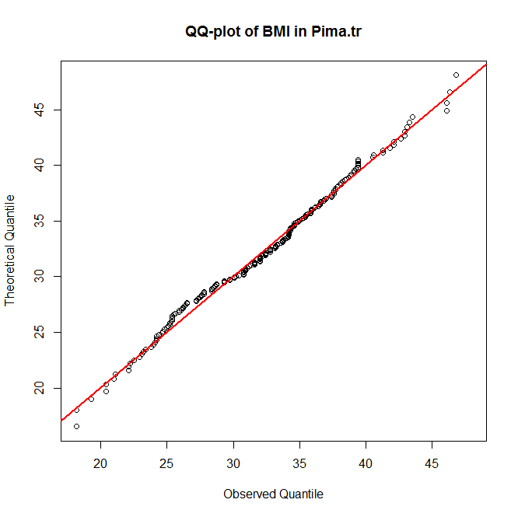
Quantile-Quantile plot
Quantile-Quantile (QQ) plot
  Comparing two distributions by plotting the quantiles of one distribution against the quantiles of the other distribution
  For goodness of fit checking

